Slide 1
Capstone Project-4
Project Title
NETFLIX MOVIES & TV SHOWS CLUSTERING
TEAM MEMBERS
Bhaskar Subanji
Pranil Thorat
Jai Harish S

Slide 2
CONTENT
Introduction
Abstract
Problem Statement
Handling Null Values and feature engineering
EDA
Hypothesis Testing
Finding Number of Clusters
Algorithm
Model Performance
Interactive scatterplot of the cluster
Conclusion

Slide 3
Introduction
Netflix is a prominent OTT platform with a wide variety of content to view from a variety of nations and genres, so keep an eye on it.
The purpose is to forecast clusters based on similar content by comparing text-based features, in this example, the description column, which is a brief graphic overview of the contents.

Slide 4
ABSTRACT
The idea was to use text-based variables to anticipate clusters of related content.
The dataset is subjected to exploratory data analysis in order to extract insights from it, but the initial null results are ignored.
In addition, using EDA's findings, some hypothesis testing was done.
After that, our target variable, the description column, must be feature engineered, with NLP operations such as symbol removal, stop words, punctuation, tokenization, and vectorization using TFIDF done on it.
All that was left was to discover the clusters, fit our models based on the number of clusters, and evaluate the model using evaluation metrics.

Slide 5
PROBLEM STATEMENT
This dataset consists of tv shows and movies available on Netflix as of 2019. The dataset is collected from Flixable which is a third-party Netflix search engine.
In 2018, they released an interesting report which shows that the number of TV shows on Netflix has nearly tripled since 2010. The streaming service’s number of movies has decreased by more than 2,000 titles since 2010, while its number of TV shows has nearly tripled. It will be interesting to explore what all other insights can be obtained from the same dataset.
Integrating this dataset with other external datasets such as IMDB ratings, rotten tomatoes can also provide many interesting findings.

Slide 6
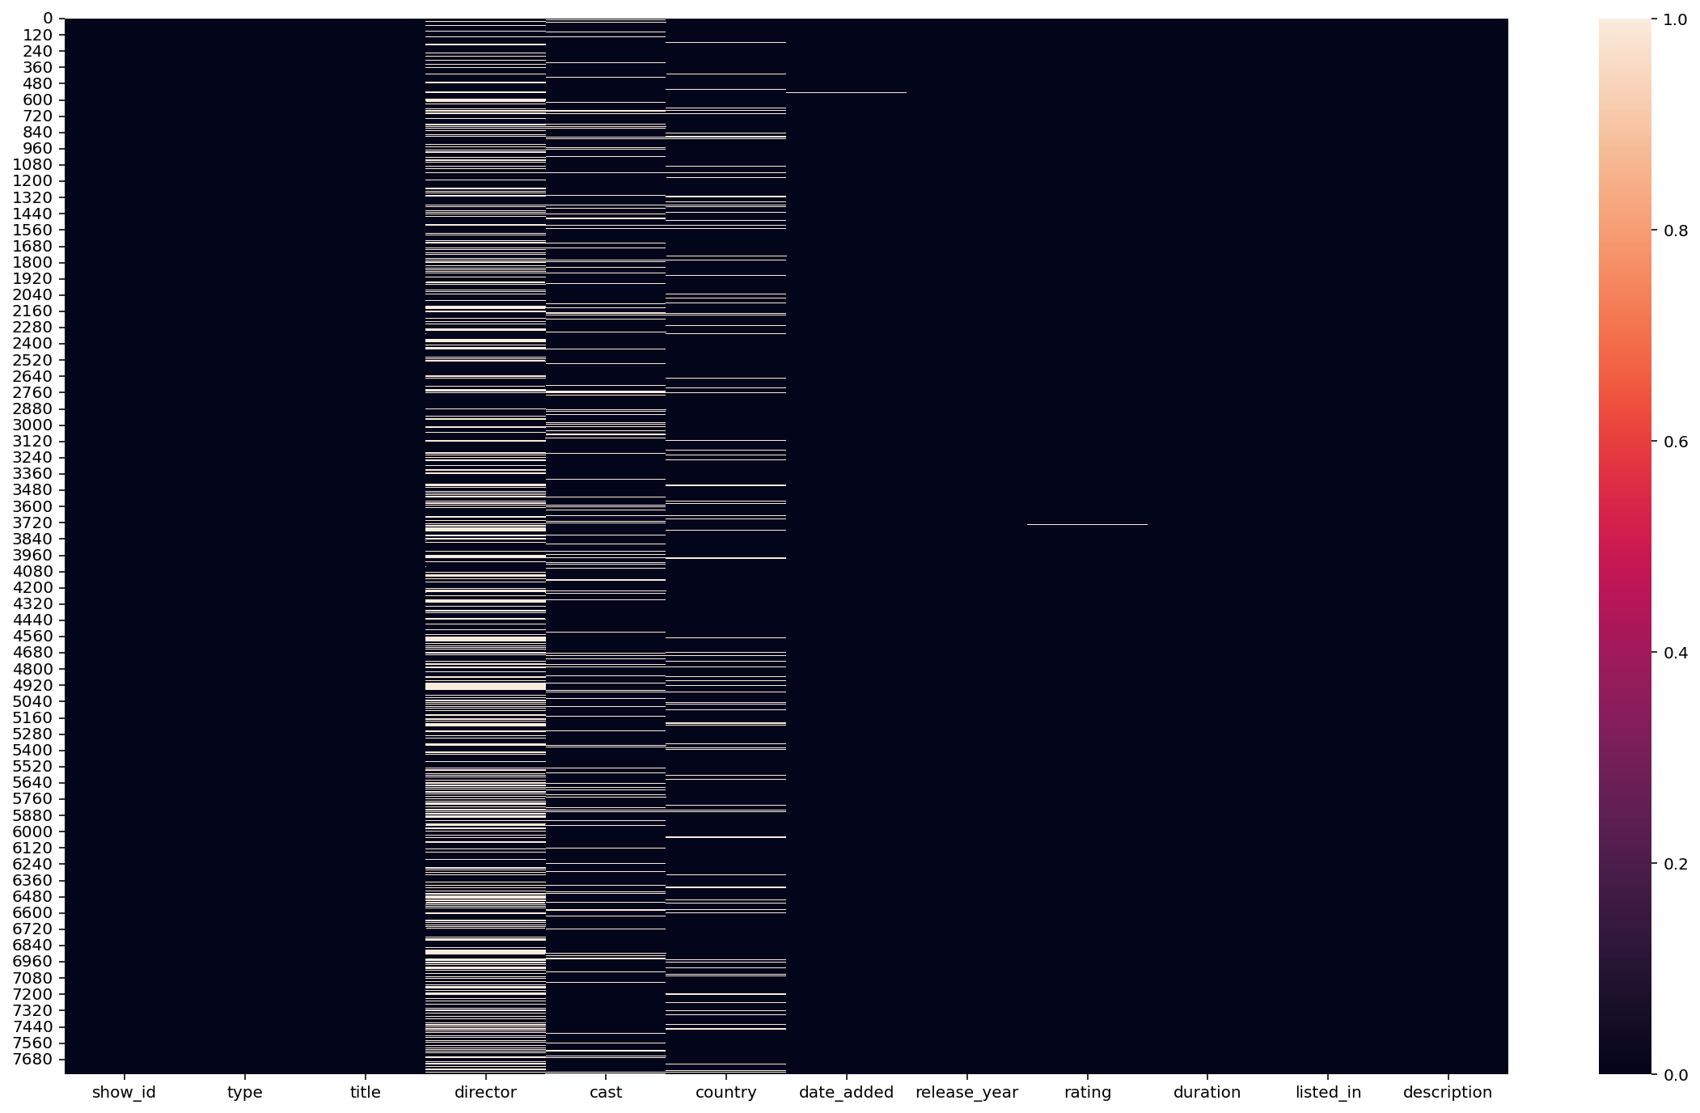
Handling Null Values and feature engineering
We checked for null values after loading the dataset and removed the null values, as well as some unnecessary columns.

Slide 7
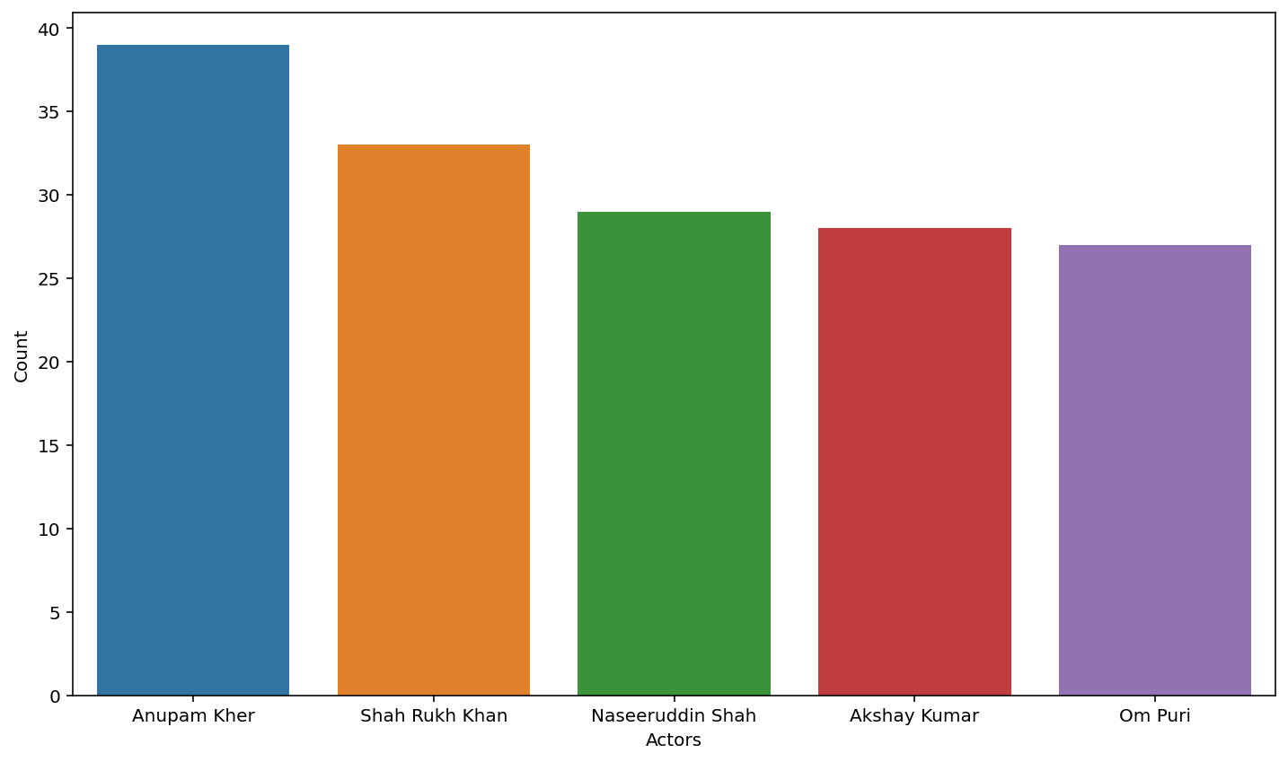
EDA
Name of the Actors who acted more times only for Indian Movies?
As we can see from the plot, Anupam Kher has acted in more Indian films than anyone else.

Slide 8
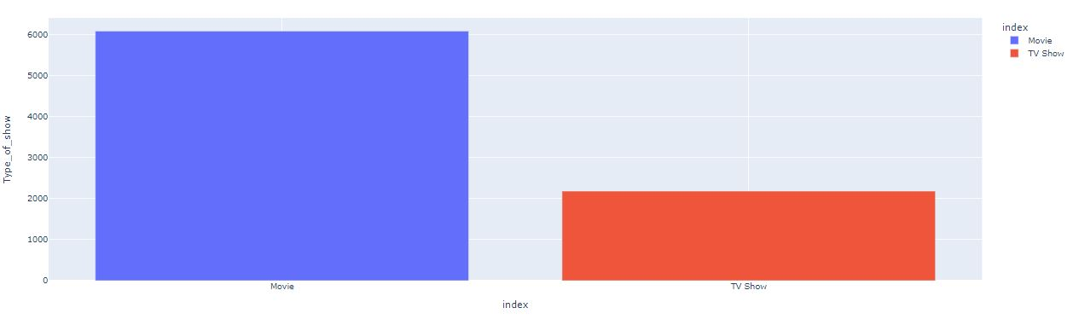
EDA cont.
What is more popular on Netflix, movies or TV shows?
As we can see in the plot, there are more movies available on Netflix compared to TV shows. That means movies are more popular than TV shows.

Slide 9
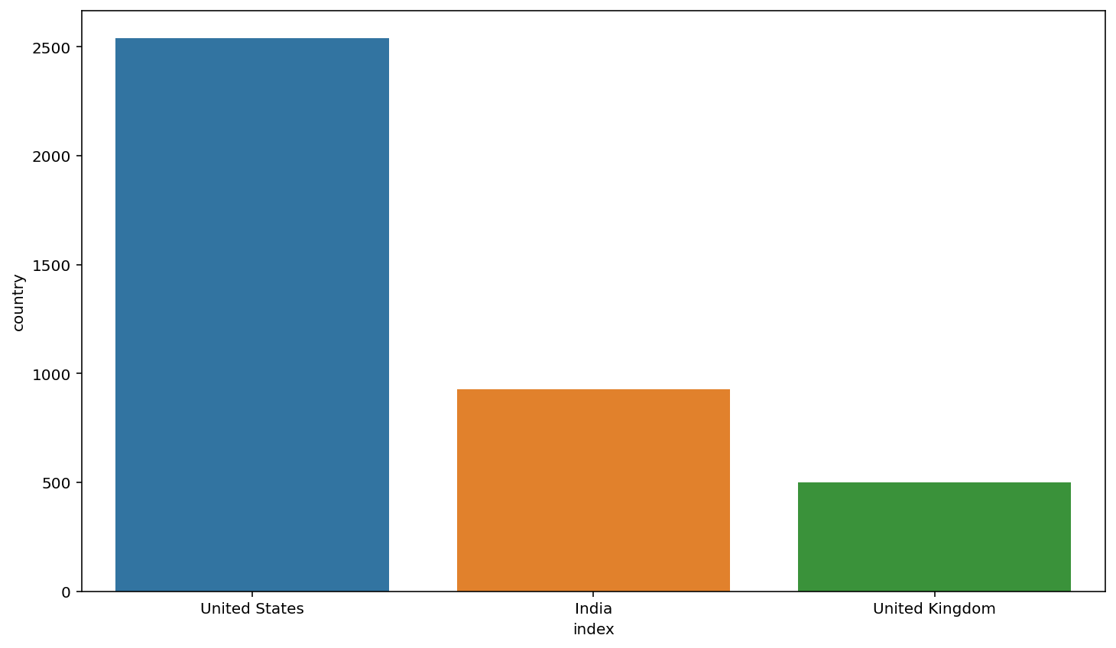
EDA cont.
Analysis of the top two countries where Netflix is most popular?
As can be seen in the plot above, the United States and India are the two countries where Netflix is most popular.

Slide 10
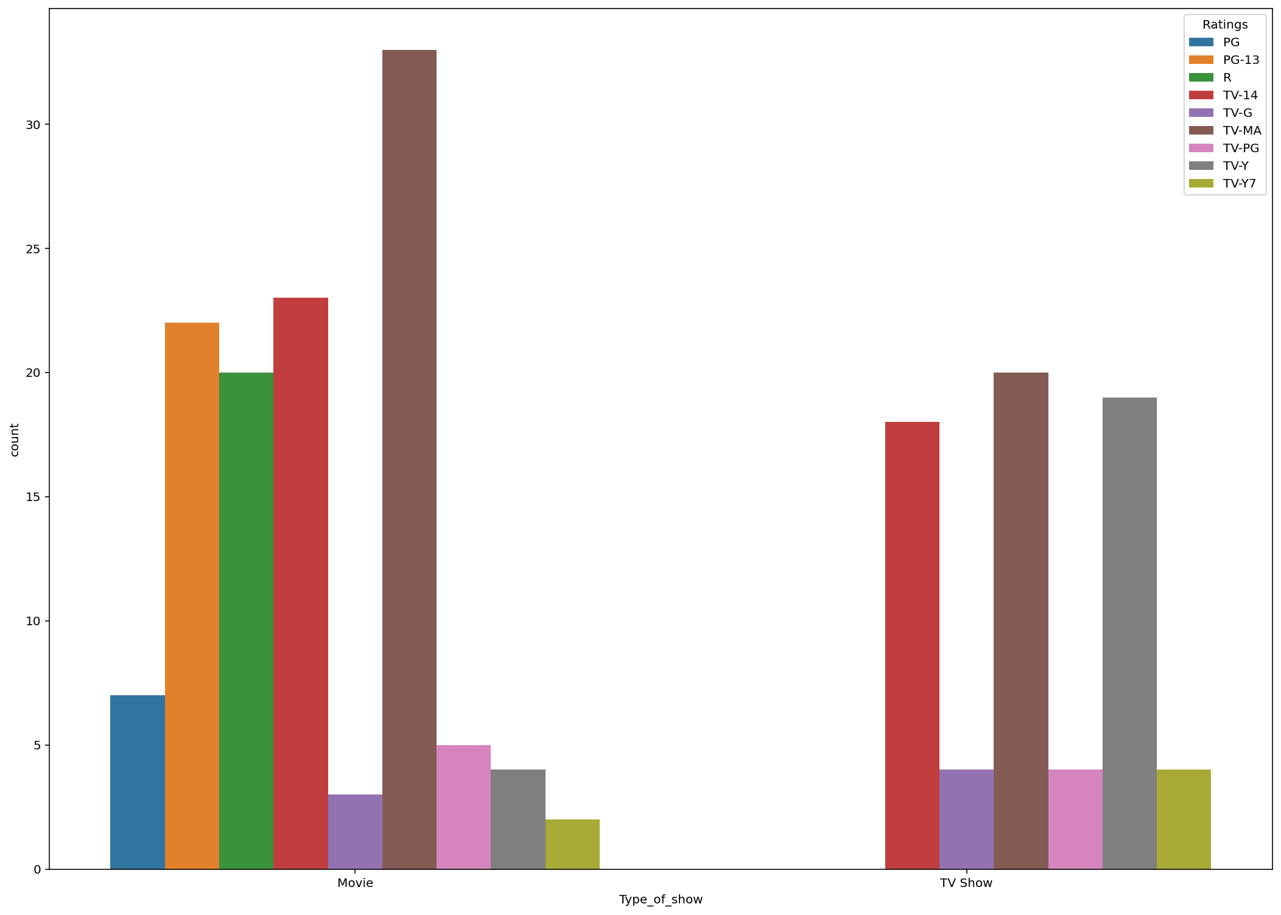
EDA cont.
Analysis of type of shows launched and highest rating of movie in December 2020?
As shown in the plot above, TV-MA ratings in December 2020 are the highest in movies and TV shows, with TV-MA standing for Mature Audience Only. Because this programme is intended for adults, it may not be appropriate for children under the age of 17.

Slide 11
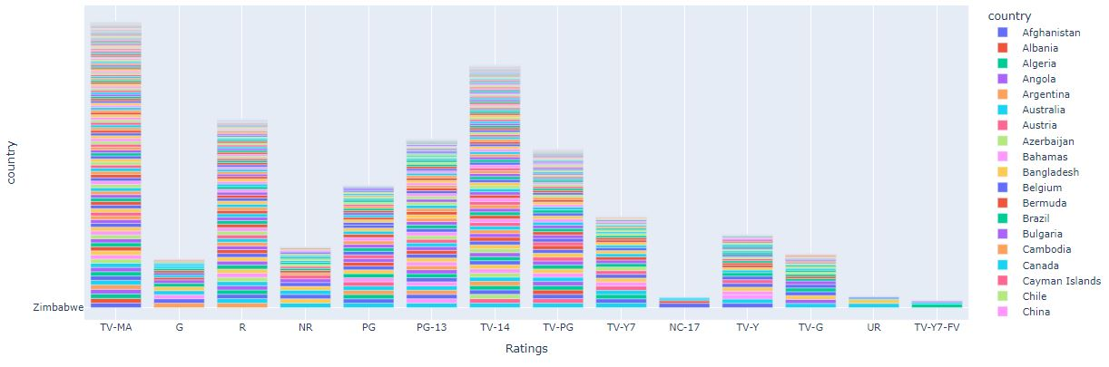
EDA cont.
Analysis of type of content available in different countries?
As we can see from the plot above, there are various types of content available, but in most countries, TV-MA content is available, and the TV-MA rating you see on many Netflix TV series signifies that the programme is only suitable for mature viewers. A TV show with a TV-MA rating features graphic violence or a combination of brutal violence. So that could be the reason for it, because the Netflix audience enjoys this type of content.

Slide 12
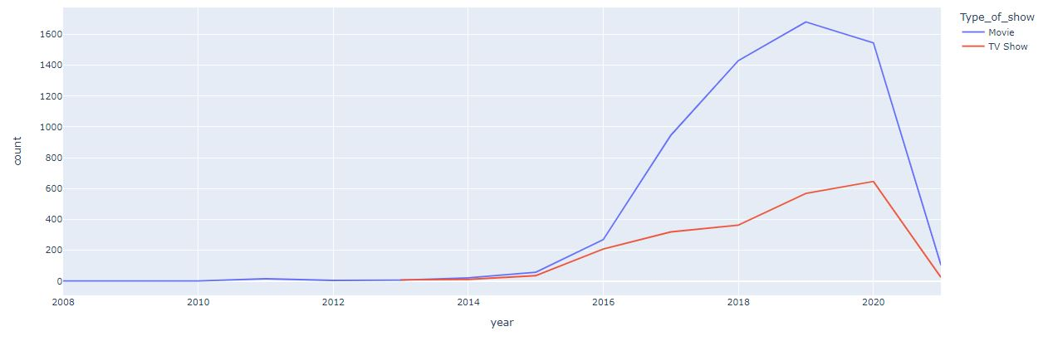
EDA cont.
Analysis of Netflix, whether it is focusing on Movies or TV Shows?
In the plot above, we can see that Netflix has been increasingly focusing on movies rather than TV shows in recent years, as evidenced by the fact that after 2014, Netflix has relied more on movies than TV shows.

Slide 13
Hypothesis testing
In the df_hypothesis variable, we copied the data frame from the df_clean_frame variable.
Then we did some data augmentation, such as assigning the ratings into grouped categories—
ratings_ages = {
'TV-PG': 'Older Kids', 'TV-MA': 'Adults',
'TV-Y7-FV': 'Older Kids', TV-Y7': 'Older Kids',
'TV-14': 'Teens', 'R': 'Adults',
'TV-Y': 'Kids', 'NR': 'Adults',
'PG-13': 'Teens', 'TV-G': 'Kids',
'PG': 'Older Kids', 'G': 'Kids',
'UR': 'Adults', 'NC-17': 'Adults'’}

Slide 14
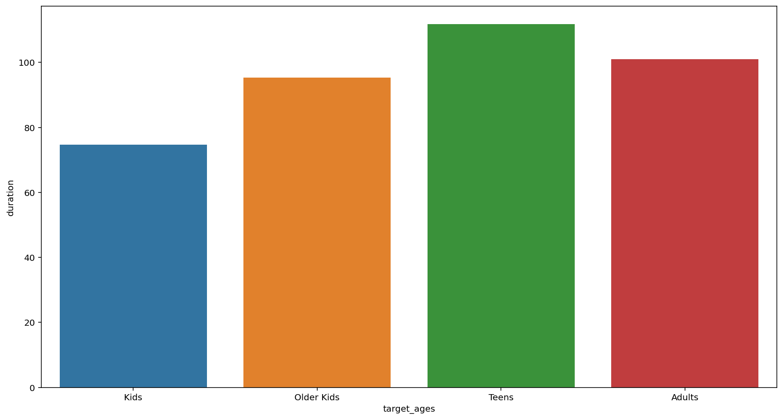
Hypothesis testing cont.
As shown in the graph above, teens have the longest average duration of time for movies, while kids have the lowest.
Then we made one hypothesis as kids and older kids rated movies are of at least 2 hours long.
Then we need to reject the null hypothesis because the t-value was not in the range.
As a result, movies rated for kids and older kids are not at least two hours long.

Slide 15
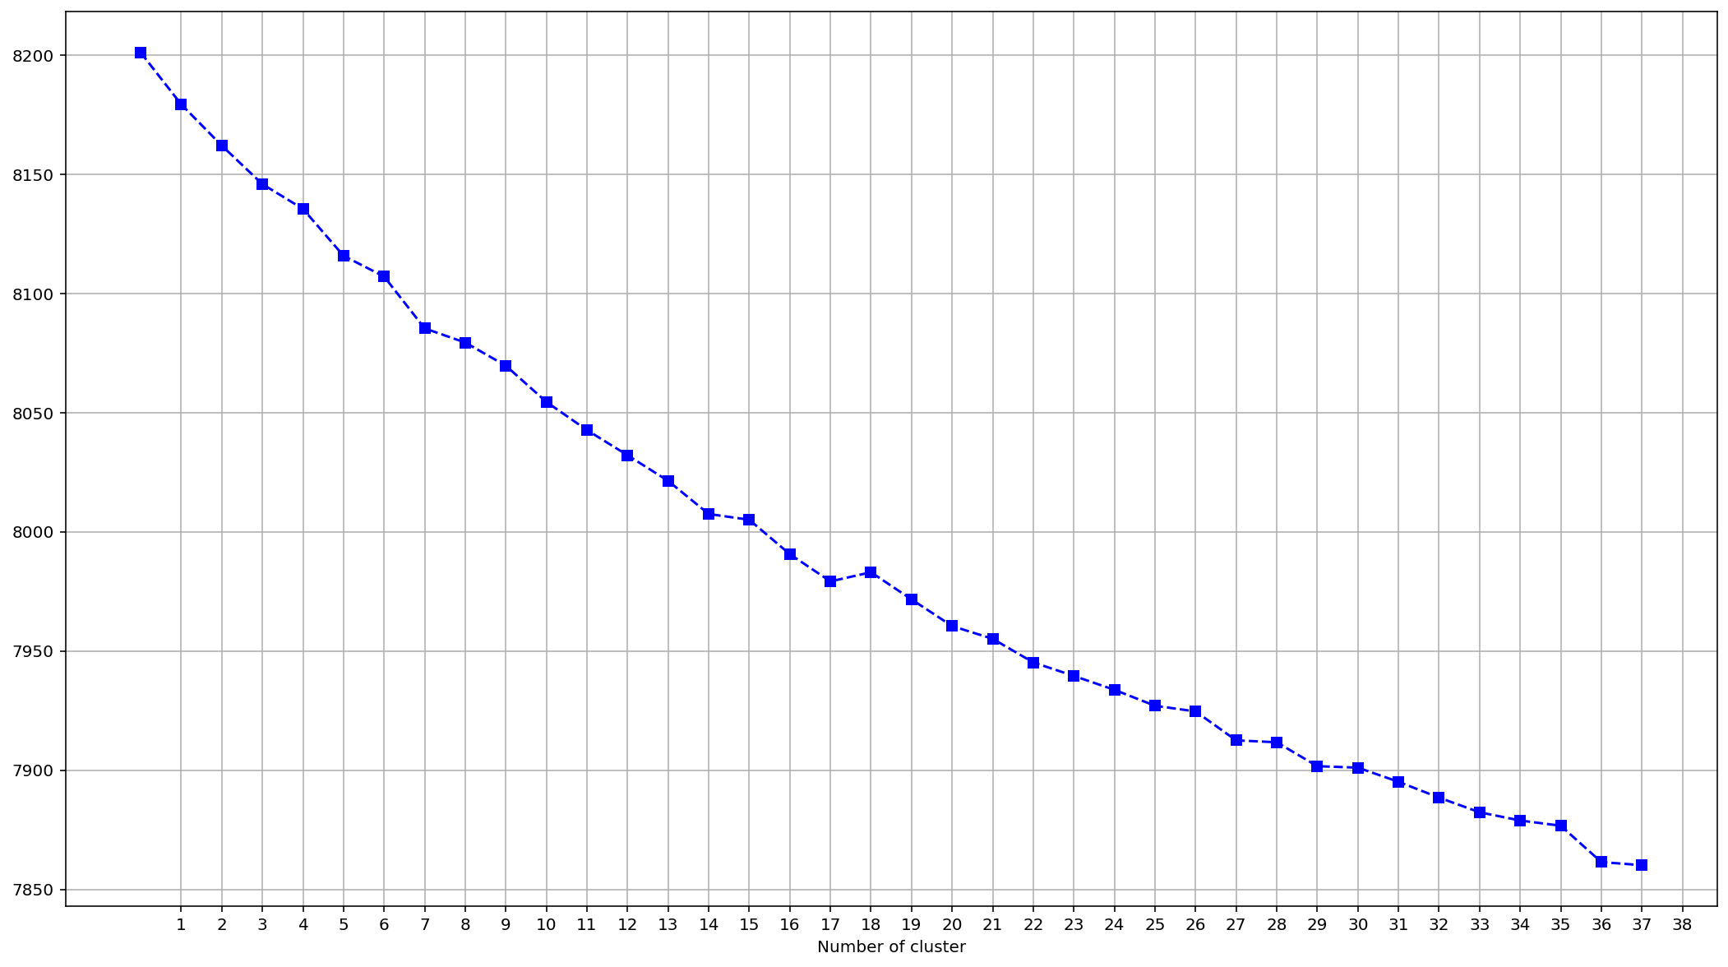
Finding Number of Clusters

Slide 16
Finding Number of Clusters cont.
Clustering is the process of splitting a population or set of data points into many groups so that data points in the same group are more similar than data points in other groups. To put it another way, the goal is to separate groups with similar characteristics and assign them to clusters.
We used the Elbow method and the Silhouette score to do so, and we chose the 28 clusters based on the results.

Slide 17
Algorithm
Implementation of Kmeans clustering-
After deciding to use 28 clusters, we used the KMEANS clustering algorithm and then we created another column where each row is assigned to its separate clusters.
After assigning clusters, most of the points were assigned to cluster number 9, and the rest of the points were not evenly distributed among all the clusters.

Slide 18
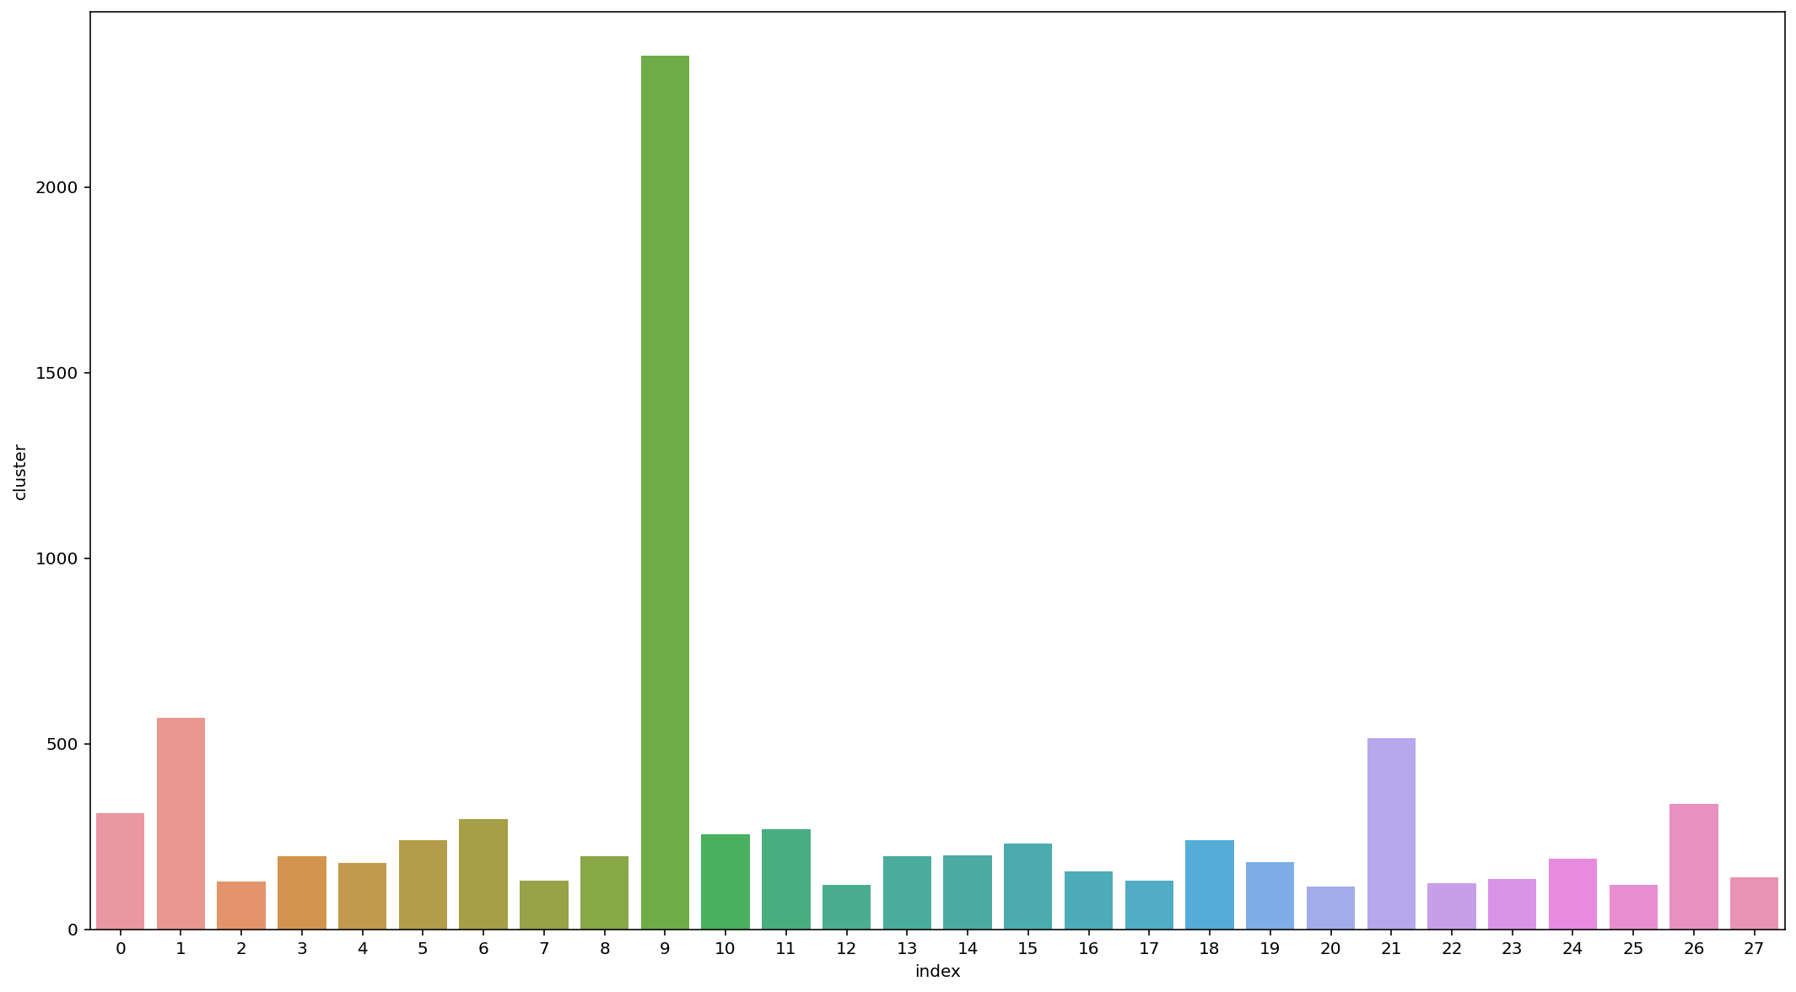
We can observe in the above plot that cluster 9 has the most clusters 2354, while cluster 1 has the second most clusters 569.

Slide 19
Model Performance
Evaluation of our K Means model -
Silhouette’s score was -0.0103
Calinski Harabasz score -10.5299
Davies Boulden Index-9.1133
The Calinski-Harabasz index also known as the Variance Ratio Criterion, is the ratio of the sum of between-clusters dispersion and of inter-cluster dispersion for all clusters, and Computed the Davies-Boulden score → The score is defined as the average similarity measure of each cluster with its most similar cluster, where similarity is the ratio of within-cluster distances to between-cluster distances.
As a result, we can conclude that our cluster is homogeneous within a cluster and heterogeneous with respect to other clusters.

Slide 20
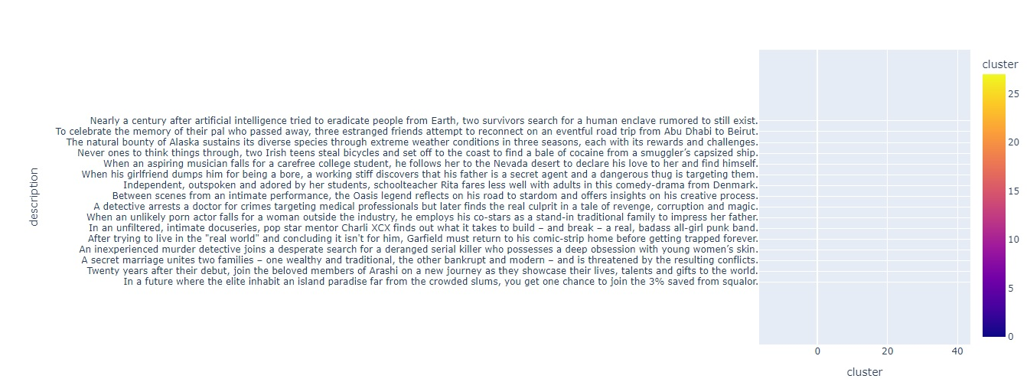
Interactive scatterplot of the cluster

Slide 21
Conclusion
We've done null value treatment, feature engineering, and EDA since loading the dataset, and then we've completed some tasks that were assigned to us.
In this context, we've noticed that Netflix is increasingly focusing on movies rather than TV shows, especially after 2014.
We've also found that different types of content are available in different countries, but TV-MA is the content that is available in the majority of countries. This could be because it shows that it is just for adult audiences, and the Netflix audience enjoys content like this.
We've also defined different clusters based on their content; we've defined 28 clusters and implemented the KMEANS clustering algorithm. And then we determined that cluster number nine has the most clusters; we've also plotted a scatter plot in which we may interact with similar content in connection to that cluster.

Slide 22
Thank you

